Slide 1
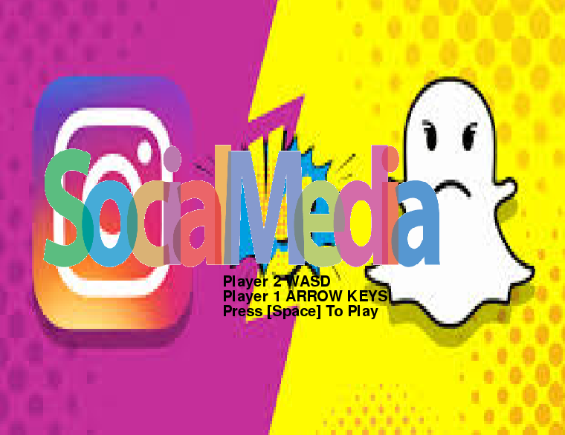
TIME LAPSE GAMING: Angela Gjoka, Elias Pena, Destiny Bermudez
Destiny, Elias, Angela

Slide 2

What is the objective of the game?
Notes:
The object of the game is to reach 50 points faster than the other player while avoiding obstacles that subtract points, or make you lose instantly.

Slide 3

What type of game is it?
Notes:
This is a two player racing game. Two players will compete and race to the end of the social media. while trying to avoid screenshots and anything that isnt a thumbs up or heart.

Slide 4
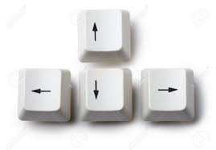
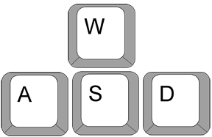
How the player will interact with your game?
Player 1 will interact with the keyboard by using the up arrow for up, down arrow for down, left arrow for left,and right arrow for right. Player 2 will interact with the keyboard also by using the key “W” for up, “S” for down, “D” for right, and “A” for left.

Slide 5

What are some of the challenges and or obstacles in the game?
Notes:
A challenge/obstacle in the game is every time a player collides with a dub, unlike or read, that player will lose one point. If a player collides with a screenshot that player will lose instantly. Each player will have to collect the thumbs up and likes until someone either dies or reaches 50 points

Slide 6
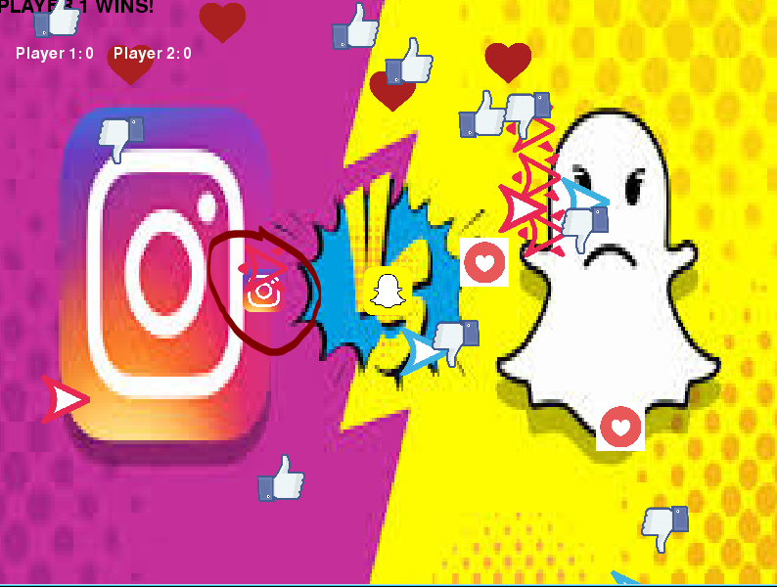
How do you win? How do you lose?
Notes:
If a player reaches the end of the maze first with the most points which is 50 they win the round. If you reach the end with less points you lose.

